Slide 1
Geospatial Visualization
CSCI 444

Slide 2
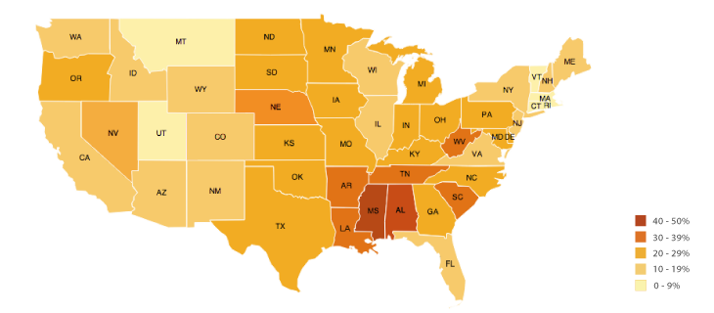
Choropleth Maps
Choropleth Map
  Data displayed on a map
  Color-coding regions based on variable’s value

Slide 3
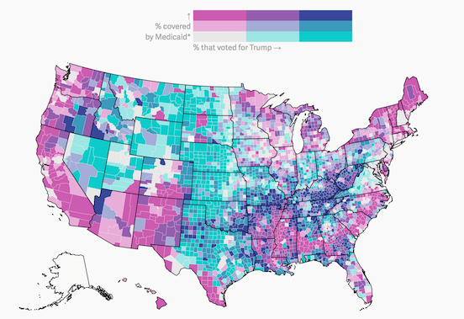
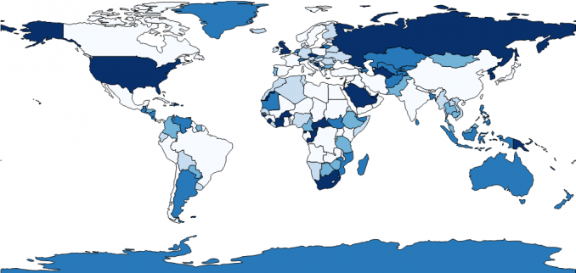
R’s map_data function
maps package
map_data("name") → retrieves latitude and longitude
Use name of map in maps
  world
  world2
  usa
  state
  county
  france, italy, nz

Slide 4
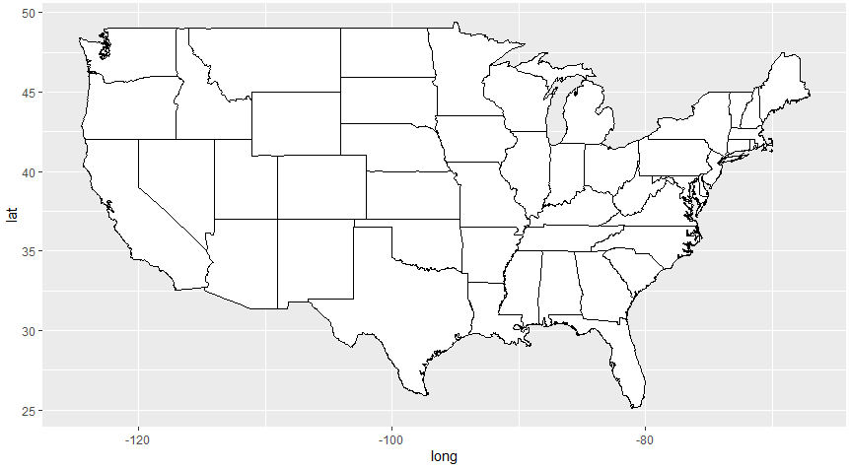
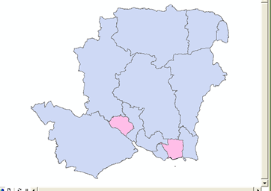
How R Builds Maps
geom_polygon → connects the polygon regions
  Uses shapefiles → maps data for complicated areas
  → nontopological format for storing
  geometric locations (e.g., GeoJSON shapefiles)

Slide 5
Example 1 – US Map
  us_states <- map_data("state")
us_states %>%
ggplot(mapping = aes(x=long,
y=lat,
group = group)) +
geom_polygon(color="black",
fill = "white") +
coord_sf()

Slide 6
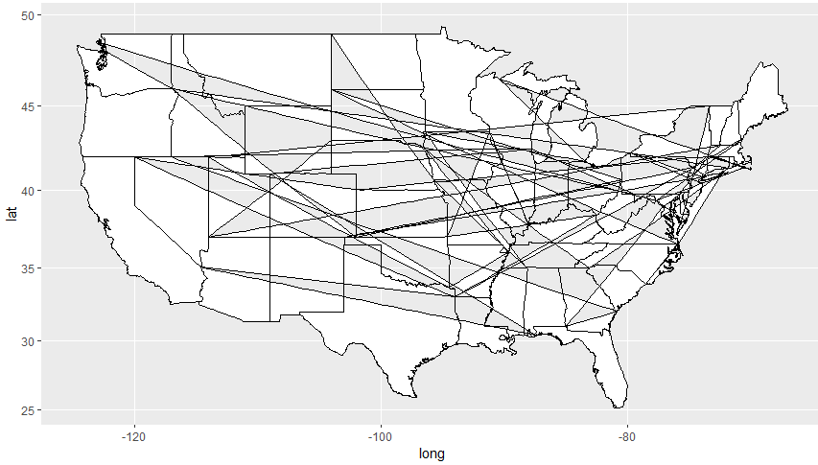
Example 1 – con’t
US Map
  REMOVE LINE → group = group
    What displays?
  R doesn’t know how to consider subregions such as the state of Washington. The group variable is by group or region → both represent one state

Slide 7
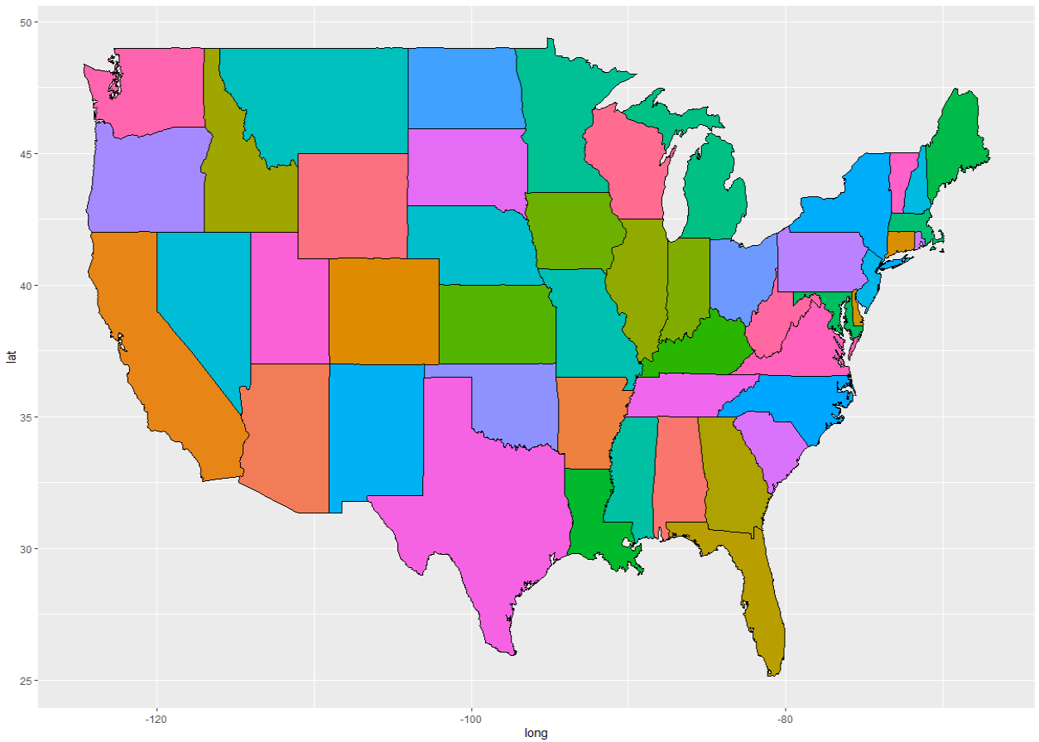
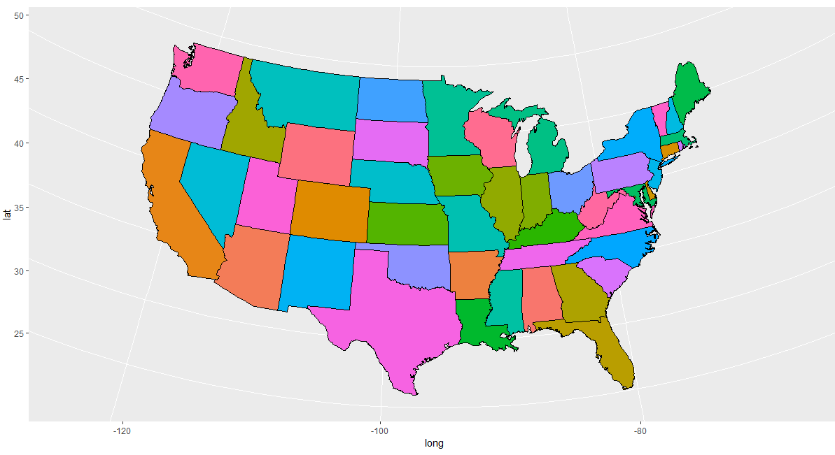
Map Projections
Mercator → default
  Based on Cartesian Coordinates
Albers → spherical projection
  Example: curving at Canadian border
mapproj package → use map projection in coord_map
  coord_map(projection = “albers”,
  lat0=39, lat1=45)
Albers requires starting and stopping latitude

Slide 8
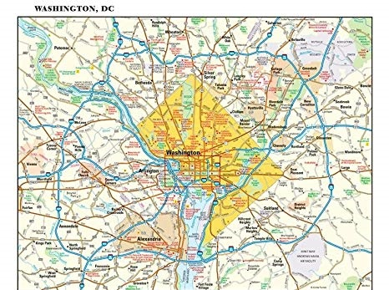
Using Maps with Data
merge(map, dataset, by=“var”)
left_join(map, dataset, by=“var”)
  Use merge with shape files and left_join with long & lab
  map & data MUST have a common variable name
  Observational Units must have same spelling
    Washington DC v. District of Columbia
    Example Code:
      mutate(region=ifelse(as.character(state) == “DC”, “district of columbia“, region))

Slide 9
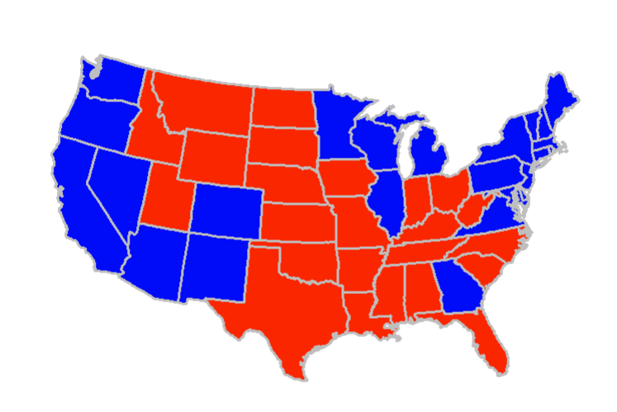
Election Data
socviz package → has 2016 election data
Update for 2020 election data
election2020 <- read_csv("./data/president_2020.csv")
election2020 <- election2020 %>%
mutate(winner = ifelse(.$`Biden/Harris` > .$`Trump/Pence`,
"Biden", "Trump"),
party = ifelse(.$`Biden/Harris` > .$`Trump/Pence`,
"Democrat", "Republican"),
region = str_to_lower(State)) %>%
select(-State)

Slide 10
Comparing Observational Units
Grab distinct region/state names
  comparison <- us_states %>%
  distinct(region) %>%
  arrange(region)
  comparisonelection <- election %>%
  distinct(region) %>%
  mutate(state = tolower(region)) %>%
  arrange(state)
Now, compare differences
  Creates a vector of differing names → returns 0 if all names are the same
  stateRegions <- setdiff(comparison$region, comparisonelection$state)
  stateRegions
  electionStates <- setdiff(comparisonelection$state, comparison$region)
  electionStates

Slide 11
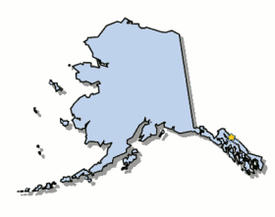
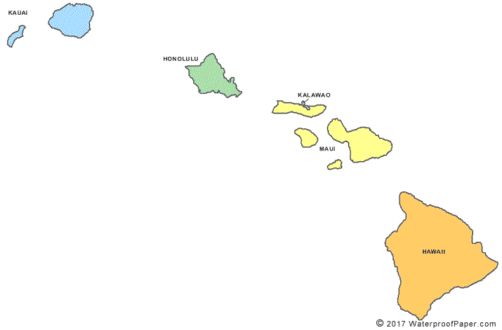
From which dataset are states missing?
  What are in the election results but NOT in the us_map data?
What are those states?

Slide 12
Election Data
left_join(us_states, election2016) %>%
ggplot(mapping = aes(x = long,
y = lat,
group = group,
fill = party)) +
geom_polygon(color = "gray") +
coord_map(projection = "albers",
lat0 = 39,
lat1 = 45) +
guides(fill = FALSE) +
scale_fill_manual(values = c("blue", "red")) +
theme_map()
Alaska & Hawaii left out
theme_map()?

Slide 13

theme_map()
theme_map()
  In the cowplot package
  Developed by Claus O. Wilke → provides map themes that create figures suitable for publication
  Removes axes ticks, lines, labels and gridlines

Slide 14
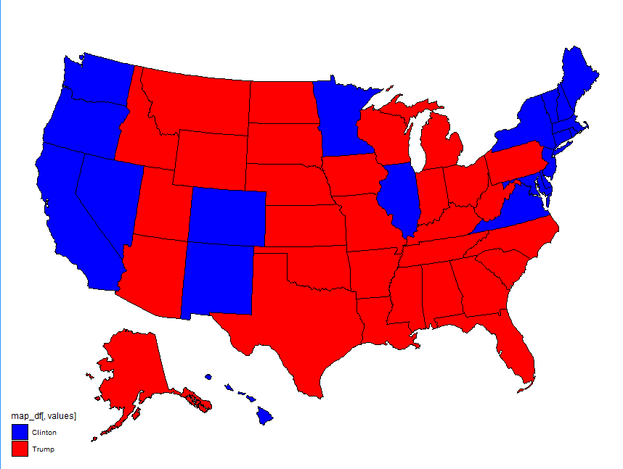
Election Data with Alaska & Hawaii
Use usmap package → has a plot_usmap function
  Includes Alaska & Hawaii
plot_usmap(regions = "states", data=election2020, values = "winner") +
scale_fill_manual(values = c("blue", "red"))
Alaska & Hawaii now included

Slide 15
Election Data using Shape Files function
election_alt <- merge(us_states, election2020,
by="region")
plot_usmap() +
geom_sf(data=election_v3, aes(fill=winner)) +
scale_fill_manual(values = c("blue", "red"))
Simple Features (sf) geometry
SF is an international standard for representing geographic features

Slide 16
plot_usmap function
function (regions = c("states", "state", "counties", "county"),
include = c(), data = data.frame(), values = "values", theme = theme_map(),
lines = "black", labels = FALSE, label_color = "black") {
if (!requireNamespace("ggplot2", quietly = TRUE)) {
stop("Please install `ggplot2`. Use: install.packages(\"ggplot2\")")
}
regions_ <- match.arg(regions)
if (nrow(data) == 0) {
map_df <- us_map(regions = regions_, include = include)
polygon_layer <- ggplot2::geom_polygon(ggplot2::aes(x = map_df$long,
y = map_df$lat, group = map_df$group), colour = lines,
fill = "white", size = 0.4)
}else {
map_df <- map_with_data(data, values = values, include = include)
polygon_layer <- ggplot2::geom_polygon(ggplot2::aes(x = map_df$long,
y = map_df$lat, group = map_df$group, fill = map_df[,
values]), colour = lines, size = 0.4)
}
include specifies a state/county
labels = TRUE will list state abbreviation in state

Slide 17
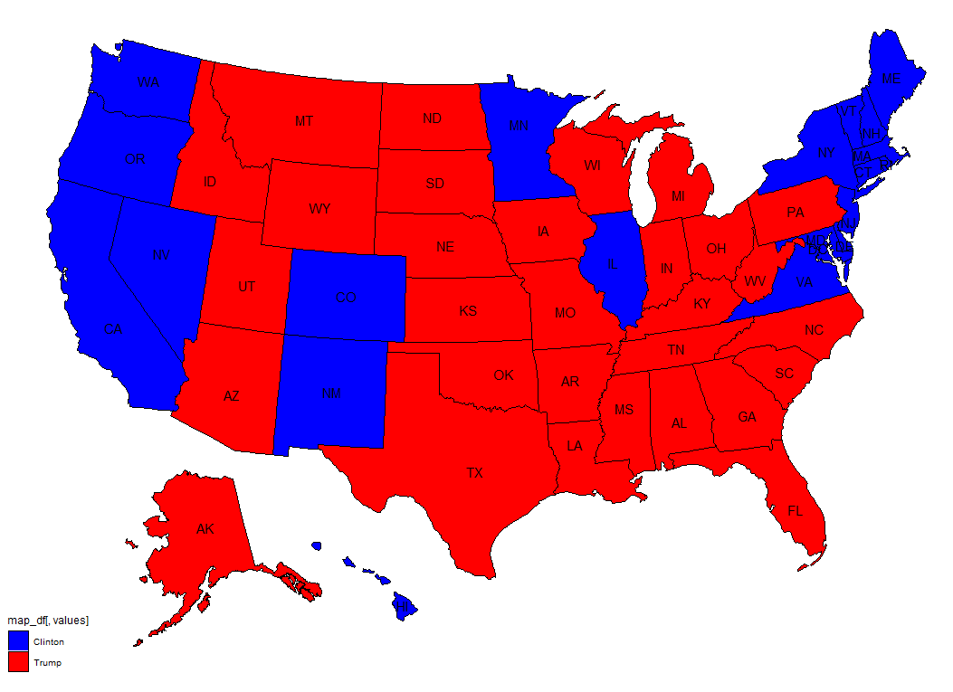
State Labels
labels parameter allows for states to be labeled
  plot_usmap(regions = "states", data=election2016, values = "winner", labels=TRUE)
  Only supported for states

Slide 18
Adding CenTroids To MAPS with Long & LAT
Centroid of a polygon is the center location
  Center of the area of each state
Need map data with BOTH map and data
  election_map <- left_join(us_states_v2, election2016, by = “region")
Bind longitude and latitude to a variable → Electoral + region
  centroid <- aggregate(data = election_map, cbind(long, lat) ~ Electoral + region, FUN=mean)
REQUIRED
Finds mean of longitude and latitude of each polygon

Slide 19
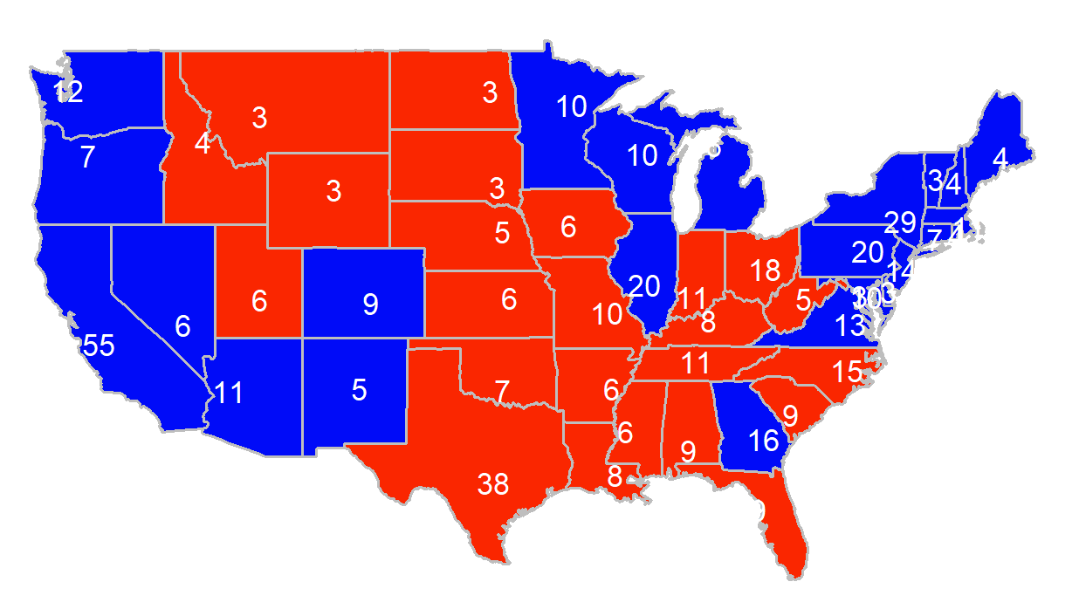
Adding Centroids
Add geom_text layer to plot
  geom_text(data = centroid,
  mapping = aes(x = long,
  y = lat,
  label = Electoral),
  color = “yellow", size = 3)
Wrap variable in sprintf to control output → sprintf(“%0.0f”, Electoral)

Slide 20
Adding CenTroids To MAPS with Shape Files
Centroid labels must have BOTH shape files and data
  centroid_labels is in the usmapdata package
  centroid_labels <- centroid_labels("states")
Need map data with BOTH shape files and data
  data_labels <- merge(centroid_labels, election2020, by = "abbr")

Slide 21
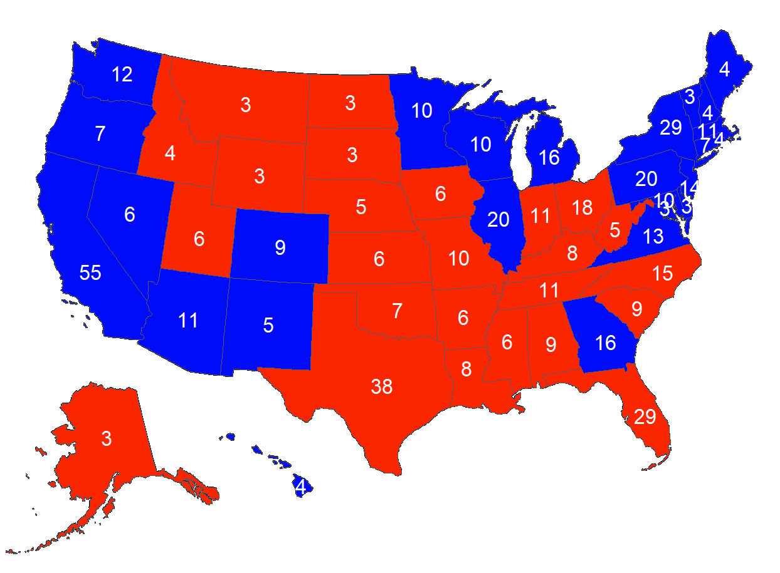
Adding Centroids
Add geom_sf_text layer to plot
  plot_usmap() +
  geom_sf(data=election2020,
  aes(fill=winner)) +
  scale_fill_manual(values = c("blue", "red")) +
  geom_sf_text(data=data_labels,
  aes(label = Electoral), color="white")

Slide 22
Example 2 – Youth Obesity
  obesity <- read_csv("ObesityYouthRisk.csv", col_names = TRUE)
  Wrangle obesity data
    Create a new variable → obesity2015
    Choose only
      “Obesity / Weight Status” for Class → watch spaces!!
      “OVR” for StratificationCategoryId1
      “Percent of students in grades 9-12 who have obesity” for Question
      2015 for YearStart
    Convert LocationDesc to lowercase
      LocationDesc defines state name
    List LocationDesc in ascending order
What states are NOT in the obesity dataset?

Slide 23
Example 2 con’t
Variables DO NOT match
  Wrangle obesity2015 to match us_map data’s variable names
    select from obesity2015 but name variables using us_map names
us_map | obesity
region | LocationDesc
class | Class
category | StratificationCategoryId1
data | Data_Value

Slide 24
Example 2 con’t
us_obesity <- left_join(us_map, obesity2015, by = "region")
Plot obesity data on a choropleth map
  Use us_map/election data as a guide
  Replace scale_fill_manual →
  scale_fill_brewer(palette = “Greens”,
  trans = “reverse”)
Let’s clean up the map
  guides(fill = guide_legend(nrow = 1)) +
  labs(title = "Obesity in the US") +
  theme_map() +
  theme(legend.position = "bottom")
Can use trans=“reverse” or direction = -1 to reverse the order of the gradient - DISCRETE

Slide 25
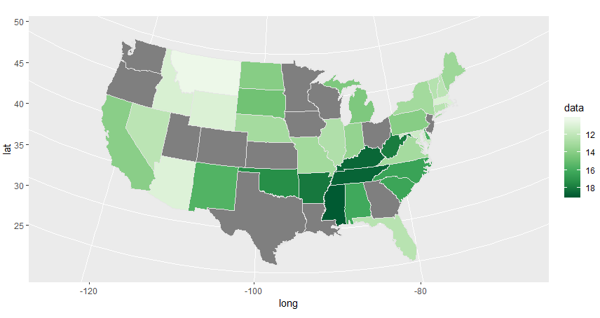
Example 2 con’t
Why are certain states gray?

Slide 26
Example 3 – Youth Obesity By Year
Create a faceted plot by year
  Wrangle obesity data
    Create a new variable → obesityYear
    Choose only
      “Obesity / Weight Status” for Class → watch spaces!!
      “OVR” for StratificationCategoryId1
      “Percent of students in grades 9-12 who have obesity” for Question
    Convert LocationDesc to lowercase
    List LocationDesc in ascending order
    Select and rename obesityYear variables → region (LocationDesc)
    → class (Class)
    → category (StratificationCategoryId1)
    → data (Data_Value)
    → year (YearEnd)
same as obesity2015 EXCEPT DO NOT filter YearStart

Slide 27
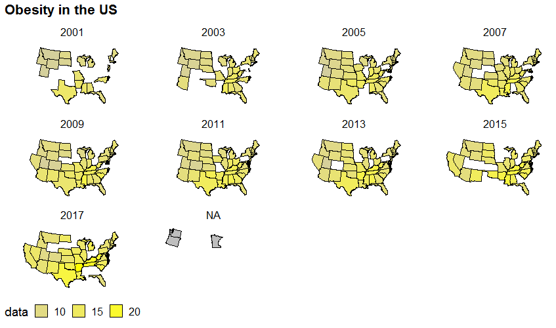
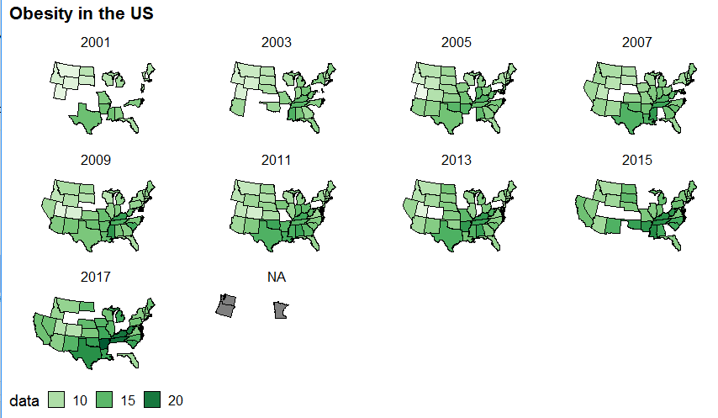
Example 3 con’t
Add a layer to facet obesity by year
  facet_wrap( ~ year)
Try changing the color scheme using gradient2
  scale_fill_gradient2(low = "green",
  mid = "gray",
  high = "yellow",
  na.value = "gray")
~ required to select a variable from obesity

Slide 28
FIPS Codes
FIPS → Federal Information Processing Standards
  Unique code for states & counties
    County FIPS begins with state’s two-number FIPS
State | County | FIPS
Alabama |  | 01
 | Autauga | 01000
 | Baldwin | 01001
 | Barbour | 01005

Slide 29
County Data with socviz package
socviz → provides county map data
  county_map & county_data
  View(county_data) → we will be using pop_dens (population density)
  glimpse(county_data)
    What is the data type of pop_dens?
    Is this a DISCRETE or CONTINUOUS value?
  counties <- left_join(county_map, county_data, by = "id")
id is FIPS code

Slide 30
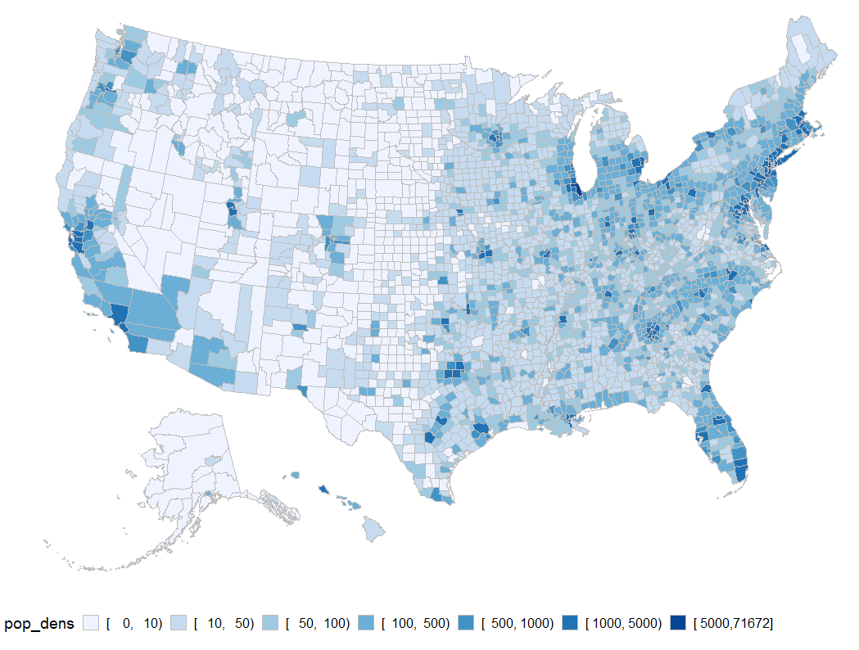
Example 4 – Plot US County Data based on Population
counties %>%
ggplot(mapping = aes(x = long,
y = lat,
group = group,
fill = pop_dens)) +
geom_polygon(color = "gray", size = 0.5) +
coord_equal() +
scale_fill_brewer(palette = "Blues") +
theme_map() +
guides(fill = guide_legend(nrow = 1)) +
theme(legend.position = "bottom")
50% of actual size

Slide 31
County Data with usmap package
usmaps → also provides county map data
  us_counties <- us_map("counties") %>%
  rename(id = fips)
  us_counties_and_data <- merge(us_counties, county_data, by="id")
  plot_usmap() +
  geom_sf(data=us_counties_and_data, aes(fill=pop_dens)) +
  scale_fill_brewer(palette = "Blues") +
  guides(fill = guide_legend(nrow = 1)) +
  theme(legend.position = "bottom")
id is FIPS code

Slide 32
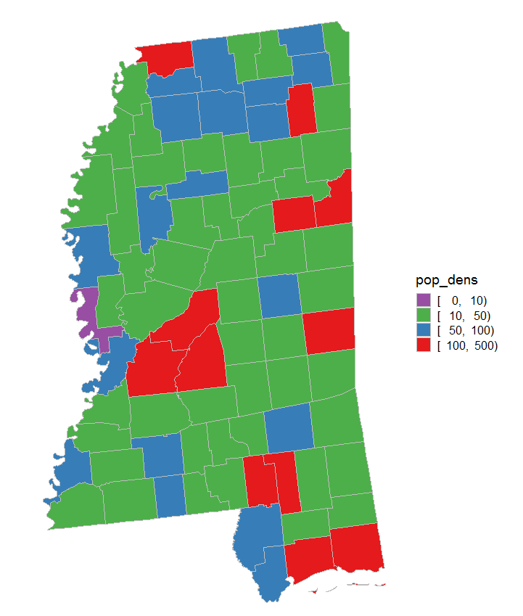
Example 5 – Mississippi Population Density with Socviz
ms <- left_join(county_map, county_data, by="id") %>%
filter(state == "MS")
ms %>%
ggplot(mapping = aes(x = long,
y = lat,
group = group,
fill = pop_dens)) +
geom_polygon(color = "gray", size = 0.5) +
scale_fill_brewer(palette = "Set1",
direction = -1) +
coord_equal() +
theme_map()
Bins in legend because this is discrete data
Can use direction = -1 to reverse colors – DISCRETE

Slide 33
Example 6 – Mississippi Population Density → Continuous
How can data be wrangled to create a new column that is continuous INSTEAD of discrete → think percentages?
MScounties <- county_data %>%
filter(state == "MS") %>%
mutate(pop_per = pop/sum(pop))

Slide 34
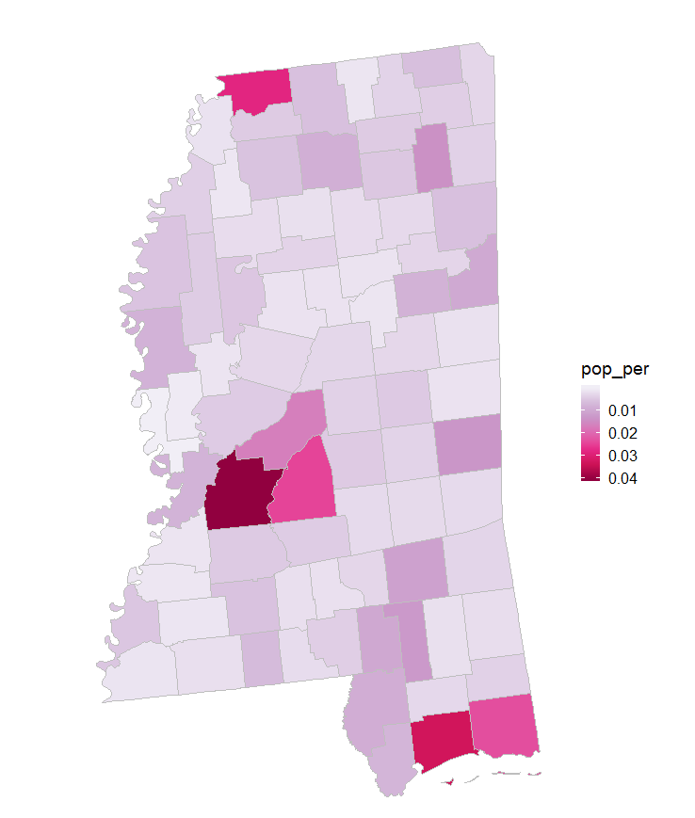
Example 6 con’t – Plot Data
Legend is continuous
MSpop <- left_join(county_map, MScounties, by = "id") %>%
filter(state == "MS")
MSpop %>%
ggplot(mapping = aes(x = long,
y = lat,
group = group,
fill = pop_per)) +
geom_polygon(color = "gray", size = 0.5) +
scale_fill_distiller(palette = "PuRd",
trans = "reverse") +
coord_equal() + theme_map()
Only use trans=“reverse” NOT direction = -1 CONTINUOUS

Slide 35
Example 7 – Mercator Projection of Mississippi
Use map_data for MERCATOR
MScountiesALT <- map_data(map="county", region="mississippi")
MScountiesALT %>%
ggplot(mapping = aes(x = long,
y = lat,
group = group,
fill=subregion)) +
geom_polygon(color="black") +
coord_quickmap() +
guides(fill=FALSE) +
theme(axis.ticks = element_blank(),
axis.text = element_blank(),
axis.title = element_blank(),
panel.background =
element_blank())
Automatic aspect ratio for map_data

Slide 36
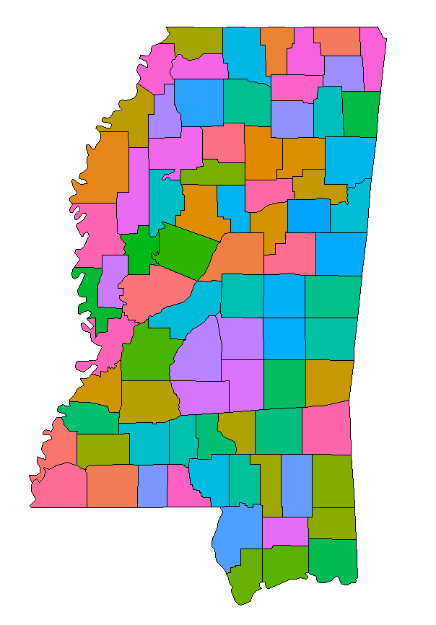
Example 7 con’t

